Slide 1
caGrid
Analytical Service Tutorial Introduction
caGrid Knowledge Center
knowledge@cagrid.org
May 6, 2009

Slide 2
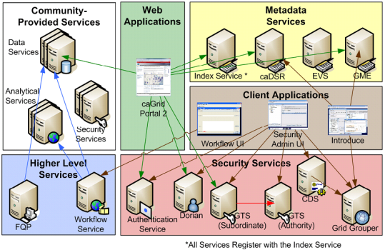
caGrid Infrastructure

Slide 3

Introduce
Introduce is the caGrid Grid Service Authoring Toolkit. Introduce allows you to create a strongly typed, semantically annotated Grid service. You can build two types of Grid services:
An analytical service provides access to analysis routines.
A data service provides access to data repositories.
Introduce is extensible. Extensions to Introduce include support for Grid security and Grid metadata. We will use both extensions in our hands on exercise.

Slide 4
Analytical Services
Every service built with Introduce is termed an “analytical service” (this is a caBIG designation)
Distinguished from data service because this service does not have a data model that can be queried
Instead, the Grid service provides service operations, such as data analysis routines, that are analogous to methods on an object

Slide 5
Service Metadata
All “caGrid” Services are expected to publish a set of standard metadata comprised of metadata registered in caDSR and EVS; metadata describes the meaning of service operations and data types and also provides details of the hosting institution that deployed the service. Metadata is used to discover Grid resources.
“Create caGrid Service Skeleton” adds service metadata extension
Standard Service Metadata
Instances of this model describe the grid service operations and parameters as well as the semantics of the data models used in the service. Standard service metadata also describes basic information about the service, such as the hosting information, including a point of contact.
Editable in Introduce as the ServiceMetadata Resource Property.

Slide 6
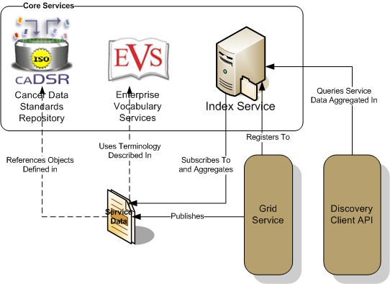
Service Advertisement and Discovery
When a grid service is deployed to caBIG, it registers its availability and service metadata with a central indexing service (Index Service).
The Index Service maintains a list of registered services and aggregates their metadata. It is the “white” and “yellow” pages of the grid.
Once the service has registered with the Index Service, users can discover the service using caGrid Portal, Globus command line tools, or incorporate the Discovery Client API in to their own applications.

Slide 7
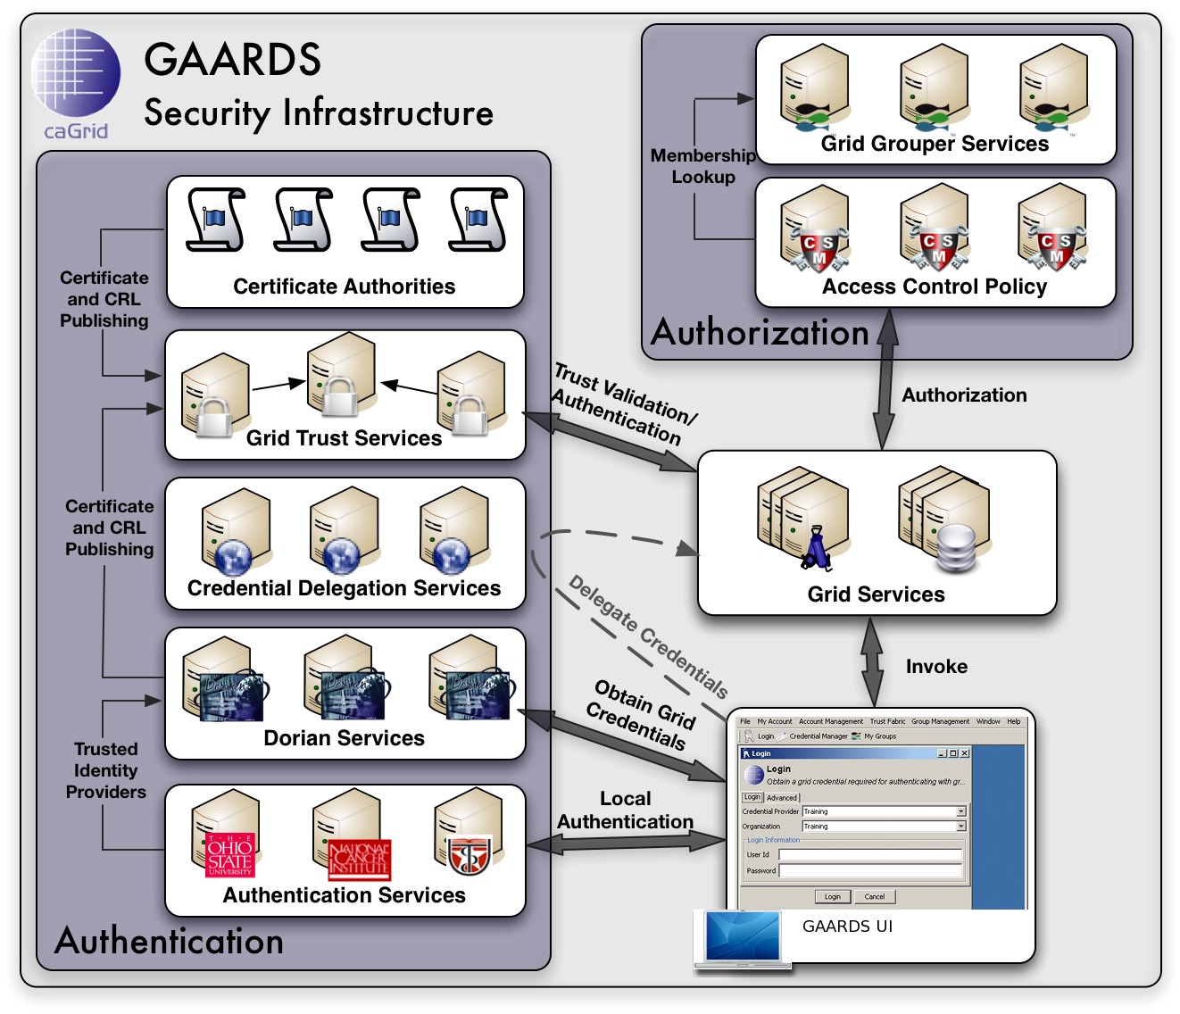
GAARDS Security Infrastructure
GAARDS provides services and tools for the administration and implementation of security policy in caGrid.

Slide 8
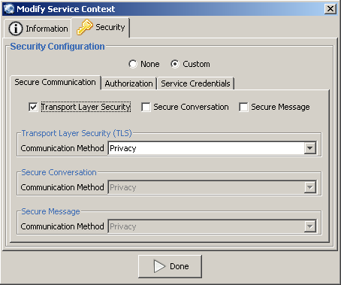
Authentication in Introduce
Introduce allows the user to customize security for the entire service or specific methods on an service context. The user can select any of the options as determined by your security policy.
Introduce Options
“None”: no authentication is performed
“Custom”: select authentication options
  Transport Layer Security – Encryption equivalent to https and requires authentication to grid.
  Secure Conversation – A security context is first established between a client and the service.
  Secure Message – A message is signed or encrypted with your grid credential.

Slide 9
Authorization in Introduce
Authorization
For secure services (with “custom” authentication specified), Introduce allows users to select authorization options to implement authorization policy. These authorization options use the client’s Grid identity to perform an authorization check. Using Introduce, users can specify an authorization check on a resource, either a service context or an operation. The user must pass the authorization check in order to access the resource.
CSM Authorization Plug-in
An extension that allows users to specify a CSM check at the service, method, or resource level.
Grid Grouper Authorization Plug-in
An extension that allows users to specify a Grid Grouper authorization expression at the service or operation level. A typical authorization expression checks whether a user is a member of a particular group.

Slide 10
Tutorial Outline
Phase 1
  Create service and add operations to the main service context
  getQuote returns a quote for a given stock symbol
  getChart returns a chart (png) for a given stock symbol
    caGrid Transfer is used to return the chart (binary data)
Phase 2
  Add a Portfolio Context (a context maintains state and is analogous to a session in a web application) and Portfolio data
  addStock Operation
  getPortfolioQuote operation returns quotes for all stocks
  enumerateStocks allows you to iterate over the portfolio contents (WS-Enumeration)
  Add a operation to the main service context to create a new portfolio context

Slide 11
Tutorial Outline (2)
Phases 3, 4, 5: Modify Resource options
  Phase 3: Lifetime management
    Set duration (expiration time) for a resource instance
  Phase 4: Persistence
    Add persistence to resources
    Resources will survive container restart
  Phase 5: Enable resource notifications
    Push notifications as resource properties are updated
    Portfolio is a resource property, so changes to the Portfolio will cause the service to send notifications
Phase 6: Security
  Secure the service and context by requiring authentication to access the service
  This requires the Grid client to have a Grid account and login to the Grid (have a credential) before contacting the service
  Then Grid Grouper authorization is used to ensure only appropriate clients can communicate with the service

